Slide 1

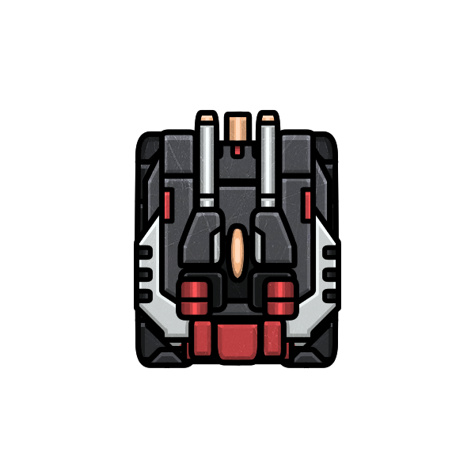
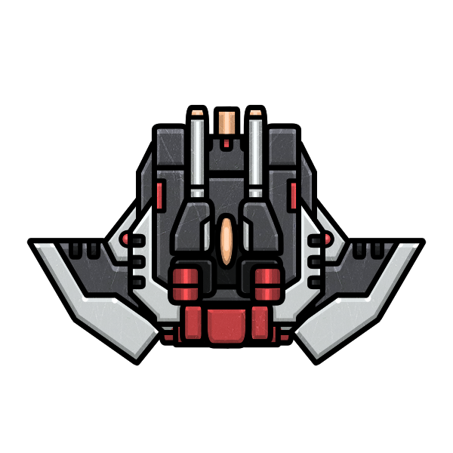
Roboarena
TO THE DEATH

Slide 2
The Team Team3
Link to the GitHub project:
https://github.com/Mesaying/
Roboarena2023Team3
Link to the sprint pages:
https://mesaying.github.io/Roboarena2023Team3/
Nico Schreiner, Roadsidepicnic1 on GitHub
Tom Wolf, Mesaying
on GitHub
Marcel John, Marcel-John
on GitHub

Slide 3
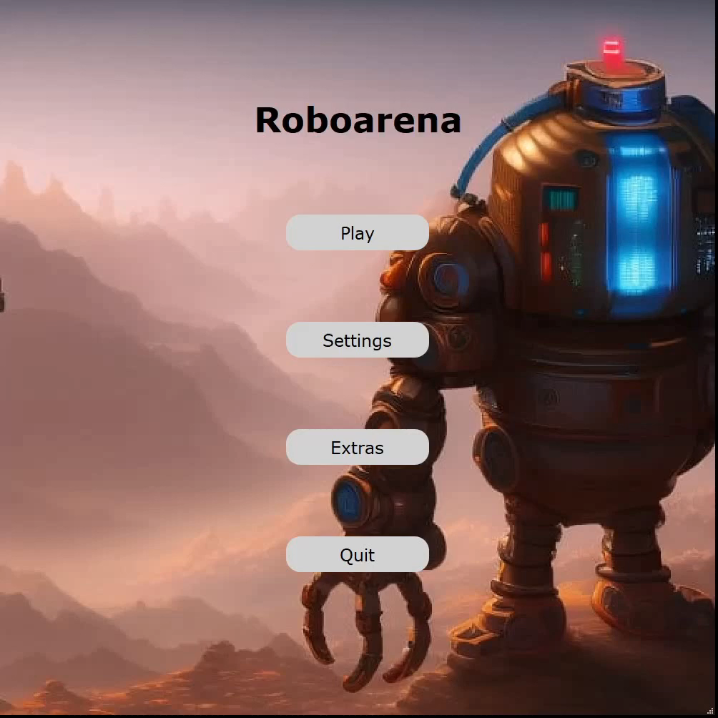
Menu structure
5 Menu windows
Connected with each other
UI designed with Qt designer
Hover effect of the buttons
Individual background images
Map editor and game startable from menu
2 different Winscreens

Slide 4
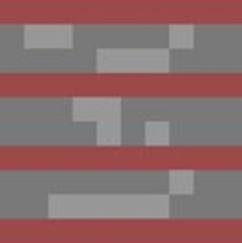


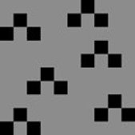


Tiles
Our Arenas consist of 6 different types of terrain each of them affecting gameplay in a different way.
Wall
Water
Walls cannot be driven through
Water slows Robots down
Boost speeds up Robots
Ground has no effect
Fire deals high amounts of damage to robots
Spikes cause moderate damage to robots
Fire
Spikes
Boost
Ground

Slide 5
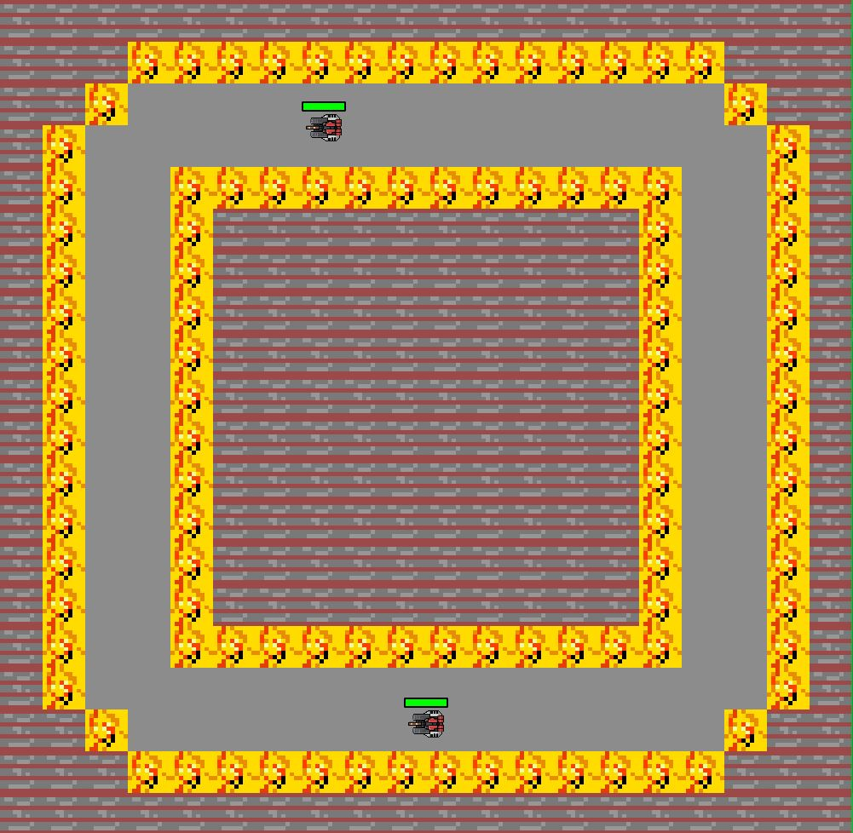
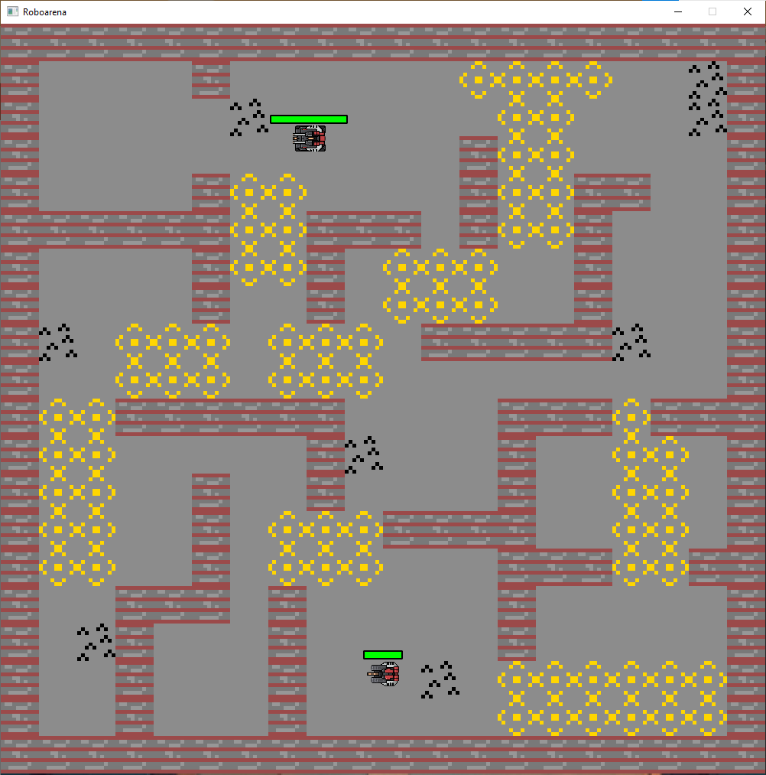
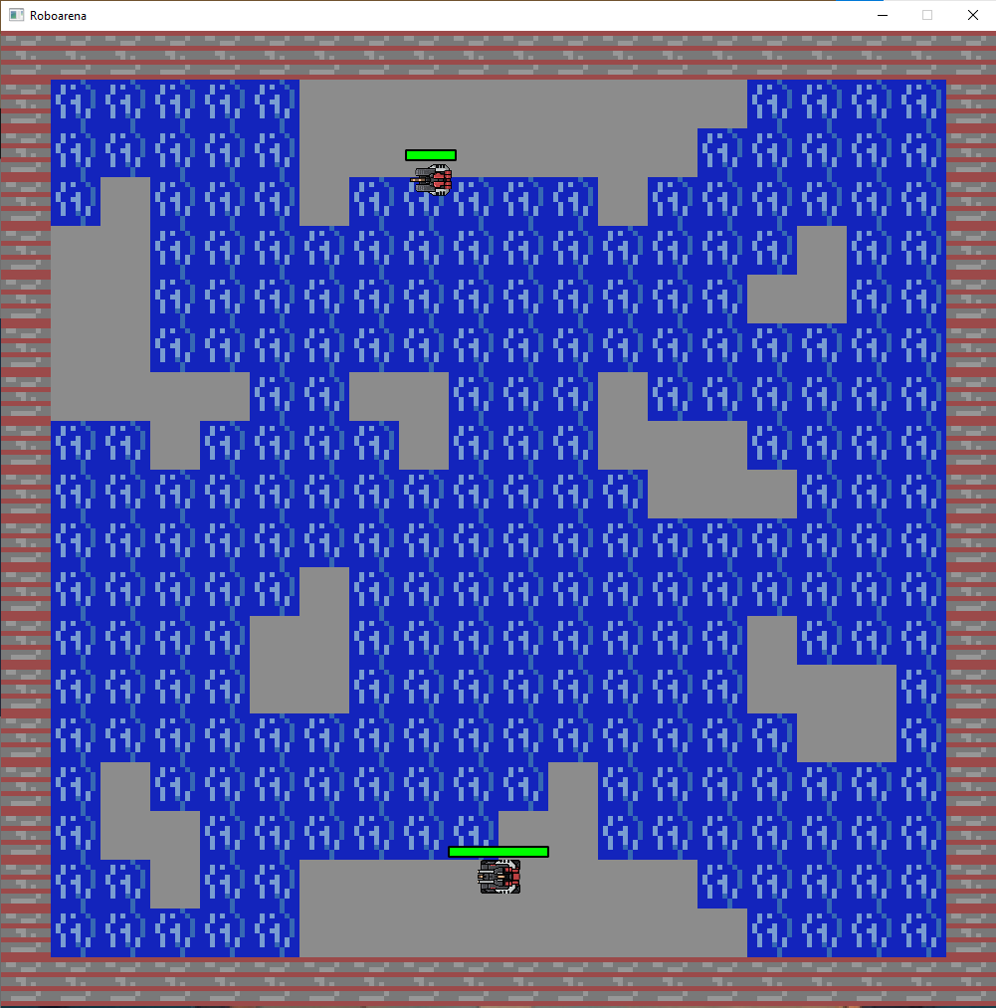
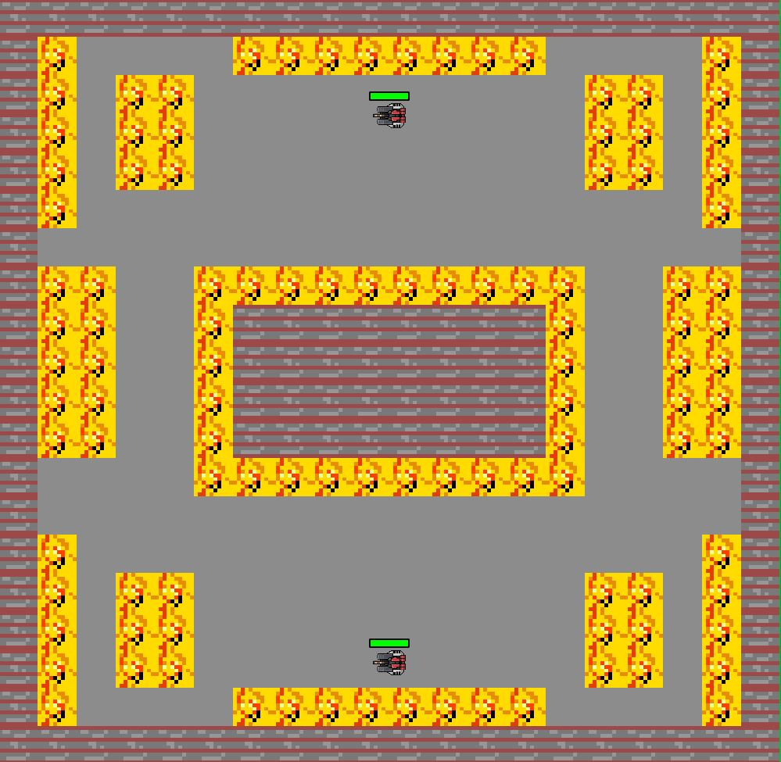
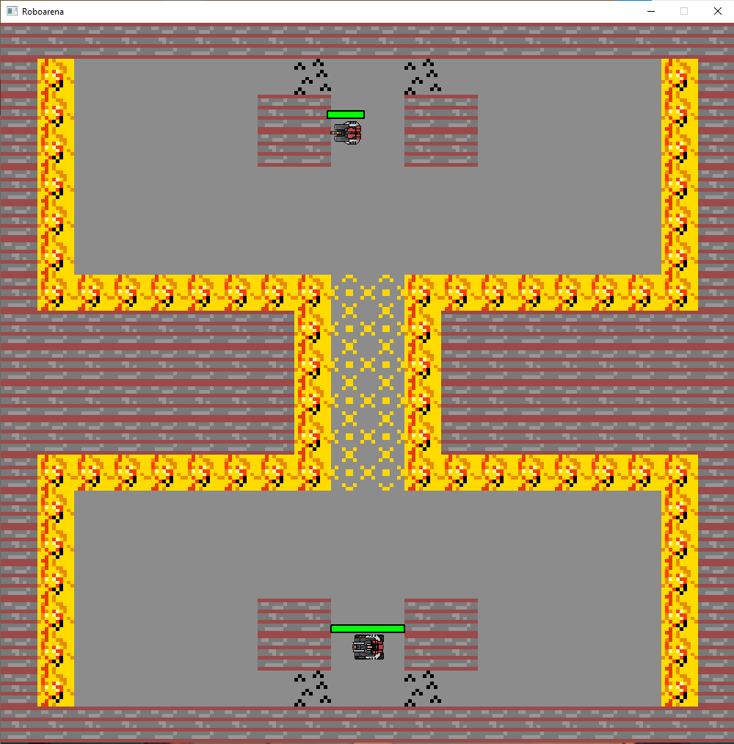
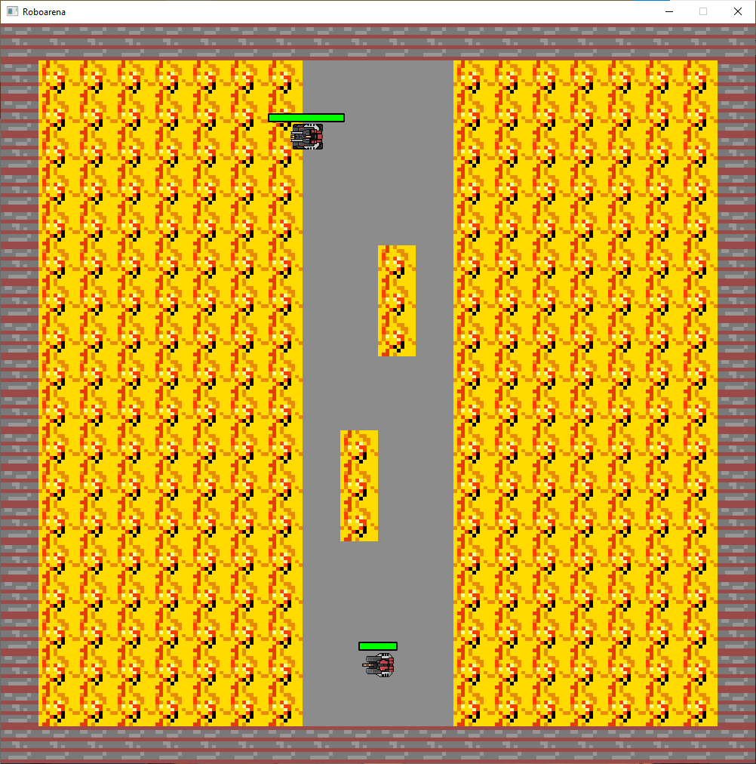
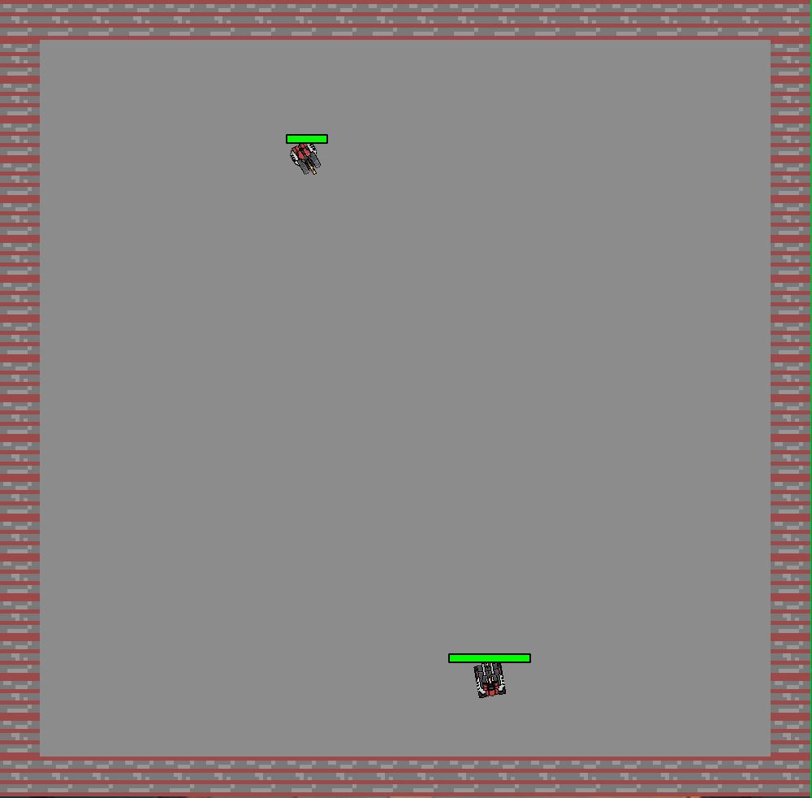
Maps
7 maps are included in the base game
Every map has a different theme
The players can create own maps using the map editor

Slide 6
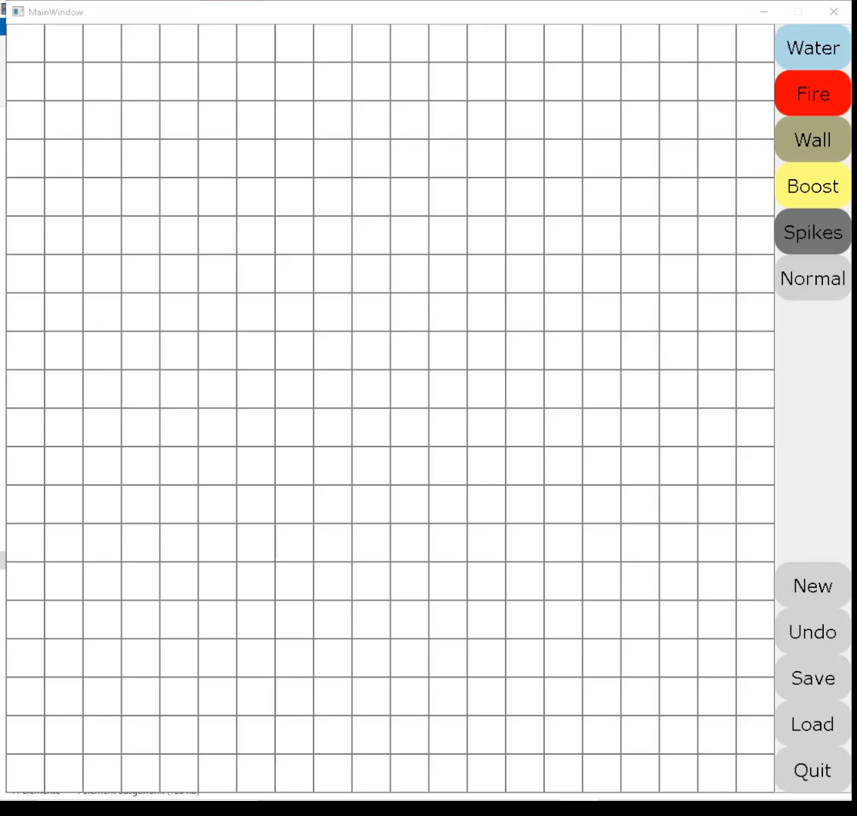

Map editor
Easy to use
Grid based: every grid resembles 1 tile of the arena
Paint terrain by clicking once or dragging the mouse
Features:
-new: delete all drawings
-undo: revert the latest drawing
-save: save the arena as text file
-load: load an already saved arena

Slide 7
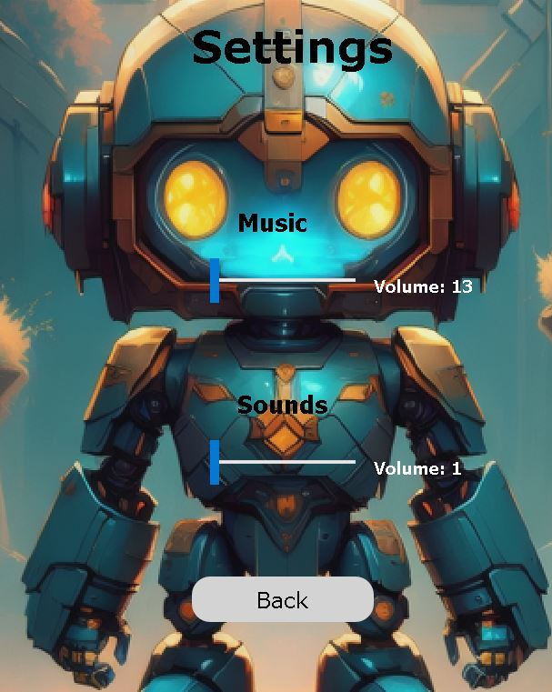


Sounds
Adjustable Volume
Relaxing Menu music
Energetic gameplay music
Sound effects for:
-Shooting
-Dashing

Slide 8
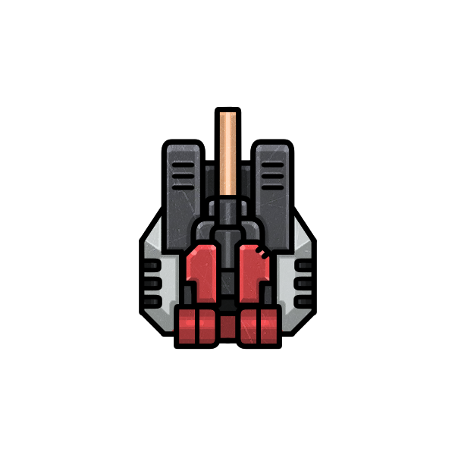
Robot Classes
Destroyer
Powerful but fragile
Tank
Resilient but immobile
Velocity Nimble but weak
Each class is differently statted and uses a different weapon, allowing for individual playstyles.

Slide 9
Weapons
The Destroyer uses the "Big Bertha" a Weapon with a low fire rate with high damage and a big Projectile. Allowing for a comeback from any situation.
The Tank utilizes an all-rounder Gun with medium fire rate and damage. In order to steadily widdle it's opponents down.
The Velocity uses the hard to master yet very powerful "Curve Ball" to catch it's opponent off guard.

Slide 10
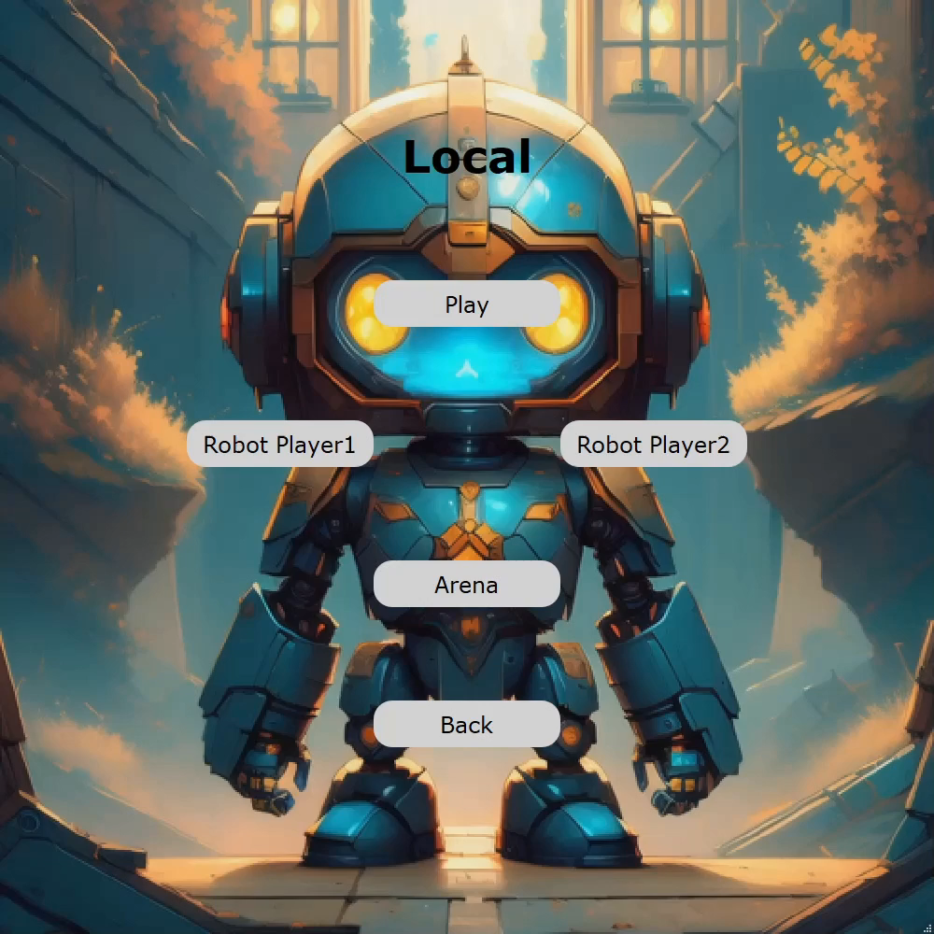



Gameplay
Intense 1 on 1 combat
Use your dash ability to evade the enemy attacks
Choose from 3 different classes to best your enemy
Player 1 shoots blue Projectiles
Player 2 shoots red Projectiles
Weapons and dash have a seperate cool down
Controls:
Player 1 moves using W, A, S, D and shift to dash as well as F to shoot
Player 2 moves using arrow keys and Ä to dash as well as Enter to shoot

Slide 11

Thank you for your attention!
Download Roboarena here:
https://drive.google.com/drive/folders/13s8gqfGhIWZ2Qlkk9gGqrCQonLyFrNhW?usp=sharing

